Slide 1
Boosting Algorithm - Regression
The boosting algorithm assesses model predictions and increases the weight of samples with a more significant error
Types of Boosting algorithm:
Ada – Boost
XG Boost
LG Boost

Slide 2
Ada Boosting
An AdaBoost regressor is a meta-estimator that begins by fitting a regressor on the original dataset and then fits additional copies of the regressor on the same dataset but where the weights of instances are adjusted according to the error of the current prediction.
AdaBoost works by fitting one weak learner after the other. In subsequent fits, it gives more weight to incorrect predictions and less weight to correct predictions. In this way, the models learn to make predictions for the difficult classes. The final predictions are obtained by weighing the majority class or sum. The learning rate controls the contribution of each weak learner to the final prediction.

Slide 3
XG Boosting - eXtreme Gradient Boosting
XGBoost is an efficient implementation of gradient boosting that can be used for regression predictive modeling. Gradient boosting is one of the variants of ensemble methods where you create multiple weak models and combine them to get better performance as a whole.
It uses weak regression trees as weak learners. The algorithm also does cross-validation and computes the feature importance. Furthermore, it accepts sparse input data.

Slide 4
LG Boost
LightGBM is a tree-based gradient boosting algorithm that uses leaf-wise tree growth and not depth-wise growth.
LightGBM supports categorical features via the `categorical_feature` argument. One-hot encoding is not needed after specifying the categorical columns.

Slide 5
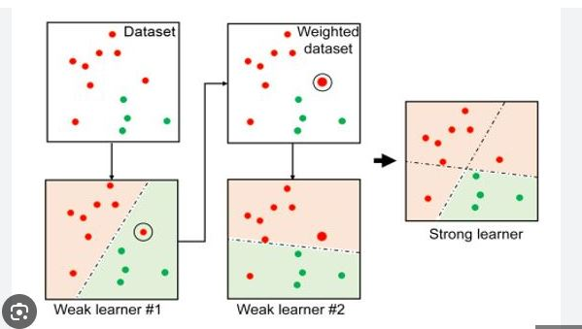
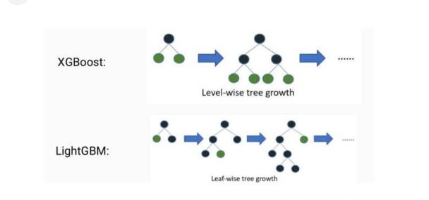
Ada Boost

